Slide 1
User Experience Study on DASH
Liu Yitong, Liu Hao, Shen Yun,
Lin Qi, Shen Hui, Li Yuchen
liuyitong@bupt.edu.cn
WT&T Lab @ BUPT
北邮、实验室全称

Slide 2
Summary
DASH QoE Evaluation
Build BUPT QoE model of DASH service
Modify UCSD QoE model （more精确的thanucsd）
Research 3 impairment factors impact on DASH service: Initial Delay, Stall, and Level Variation
Propose a QoE model of、considering level variation
集中 on Primacy and Recency Effects to propose more精确qoemodel
Identify level variation influence factors: Bitrate Switching, Bitrate Fluctuation Pattern
DASH User Experience Improvement
Study on QoE-based bitrate adaptation algorithm in DASH service
Analyze stall probability and duration
Modify real-time QoE model via stall prediction/use a relt qoe model with stal p to bitrate adaptation alg
Select bitrate level to maximize QoE
Propose a bandwidth estimating method
Detect 2 typical scenarios、从什么角度考虑的
Response quickly for long-term variation and keep stable for short-term fluctuation
Research on the performance of bitrate adaptation for multi-user DASH（On-going）
Notes:
Improve user experience of DASH service

Slide 3



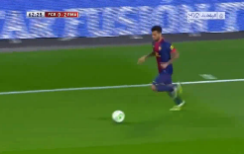
User Experience Impairment Factors on DASH Service
R = f(I_{ID}, I_{ST}, I_{LV})
Impairment due to Initial Delay
Impairment due to Level Variation
Impairment due to Stall
Medium motion
High motion
Video | Amount | Motion | Test factors
Bunny Cartoon | 11 | Medium | Stall
Movie Case | 48 | Medium | All factors*
Sport Case | 48 | High | All factors
More than 2800 votes are received
Test 107 video samples and 64 participants
Evaluation methodology: Single-Stimulus (SS)
Conclusion
All factors*: Stall, Initial Delay, and Level Variation
Impairments of Stall and Level Variation is more serious than Initial Delay.(1st row)
Initial Delay is nearly independent with Stall and Level Variation. (2nd and 3rd row)
Initial Delay and Stall Duration conform to linearity
Correlation of impairment factors
Variation | R | I_{ID} | I_{ST} | I_{LV}
R | —
I_{ID} | 0.234 | —
I_{ST} | 0.001 | 0.327 | —
I_{LV} | 0.000 | 0.927 | 0.946 | —
*Strong correlation when value <0.05
Guidance by Qualcomm Research: Yinian Mao (SD), Sha Hua (SD), and Ruiming Zheng (BJ)
Notes:
Obsvision
相关性 换成P值，加一句解释，不讲

Slide 4
Propose QoE Model
Conduct subjective test on Qualcomm’s demand
Validate the UCSD model with BUPT subjective results
UCSD model is not align、not Accurat in the BUPT subjective test
Build a new model on the basis of former conclusion
UCSD Model
BUPT Model
The best formulation out of 15 basic elementary functions.
Performance analysis
Performance of BUPT Model
Performance Validation of UCSD Model
PCC : 0.9251 MSE : 0.0536
Performance is improved, even better in low motion scenario.
Result of UCSD Model
(Provided by UCSD)
PCC : 0.91
MSE : 0.082
Our Validation Result of UCSD Model
PCC : 0.7811
MSE : 0.1821
Notes:
: Non-linear Regression

Slide 5
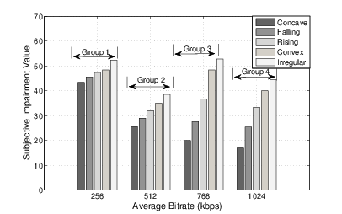
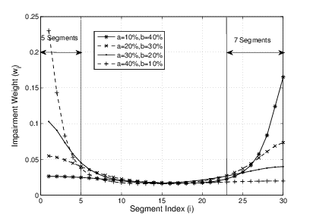
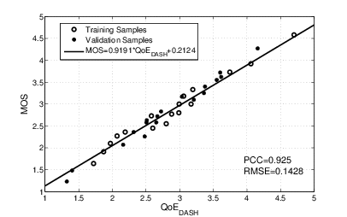
QoE Model of Level Variation
Influence factors from the subjective test:
Average bitrate
Bitrate switching frequency
Bitrate fluctuation patterns: Concave, Falling, Convex, Irregular
Impairment on bitrate fluctuation pattern (Ibfp )
Based on Primacy and Recency Effects
Evaluation functions of BFP in the posters
Impairment on bitrate switching Isw
Frequency bitrate decreased switching causes serious subjective impairment
QoE evaluation functions:
Notes:
Irregular: bitrate switches frequently with huge amplitude
QoE dash属于1-5
35 test videos from both simulated environment and real network traces
PCC= 0.92, RMSE = 0.14

Slide 6
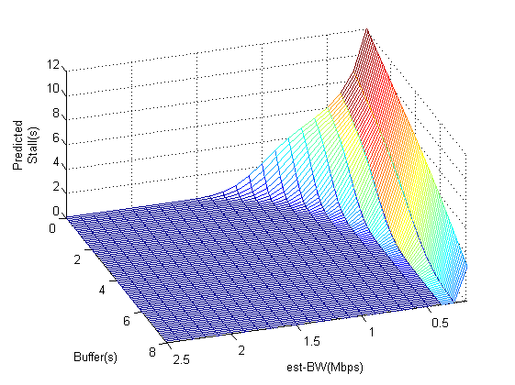



Stall Prediction of DASH Service
Segment size (bytes) obeys Gaussian Distribution ^{[1]}
Stall probability
Stall duration
Stall’s impairment ^{[2](Modified into} ^{real-time form)} （说一句话）
(1)
Stall occurs when the unequal (2) fits, i.e. When $S_{l}(i)≥S_{d}$, a stall will happen.
${TH}_{PB}$ : playback threshold
${BW}_{est}(i)$: estimated bandwidth
$Buffer(i)$ : current buffer of client
$τ$ : duration of a segment
$b_{l}$ : bit-rate of level $l$
(2)
(3)
(4)
(5)
(6)
(7)
Predicted stall duration:
$τ$=2s, $b_{l}$=2Mbps, ${TH}_{PB}$=8s
[1] Dmitri Jarnikov et al, "Client intelligence for adaptive streaming solutions “, 2011
[2] Yao Liu et al,” User Experience Modeling for DASH Video” ,2013
Notes:
${TH}_{PB}$ : playback threshold
${BW}_{est}$: estimated bandwidth
$Buffer$ : current buffer of client
$τ$ : duration of a segment
$b_{l}$ : bit-rate of level $l$
5不要了

Slide 7
QoE Based Bitrate Adaptation Algorithm
Performance simulation
*Modify QoE model^{[1]} into real-time form
*Overall Optimization^{[3]} : theoretical upper bound under a given bandwidth variation scenario.
Select bitrate level l_{selected}(i) for requesting segment i, according to:
QoS_{Net}(i) : network condition;
S(i): DASH client state(buffer length.etc);
KPI_{DASH}(i-1): previous KPIs of DASH( stall, initial delay, level variation etc.).
Orient to maximize use experience
[1] Yao Liu et al,” User Experience Modeling for DASH Video” ,2013.
[2] Dongeun Suh et al, "QoE-enhanced Adaptation Algorithm over DASH for Multimedia Streaming" 2014.
[3] Dmitri Jarnikov et al, "Client intelligence for adaptive streaming solutions “, 2011.
Notes:
标题 in dash

Slide 8
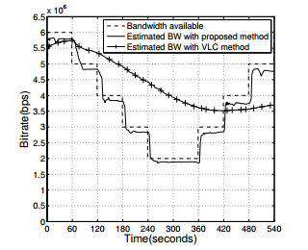
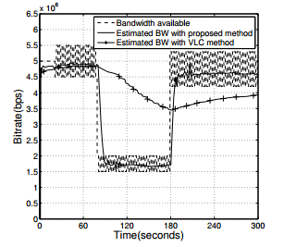

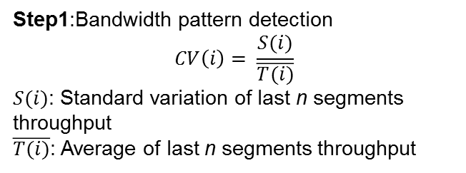
Bandwidth Estimation in DASH
2 typical scenarios
Long-term variation within a wide range – Response quickly.
Short-term fluctuation within a narrow range – Keep stable.
Step1:Bandwidth pattern detection
$$CV\left(i\right)= \frac{S(i)}{\overline{T(i)}}$$
$S(i)$: Standard variation of last n segments throughput
$\overline{T(i)}$: Average of last n segments throughput
Step 2: Bandwidth computation
$${BW}_{e}\left(i\right)= \sum_{j=i−n−1}^{i−1}{p\left(j−\left(i−n−1\right)\right)T(j)}$$
$p\left(k\right)= \left\{\begin{aligned}\frac{e^{k}}{\sum_{i=0}^{n−1}{e^{i}}} if CV\left(i\right)>0.1 \\ \frac{1}{n} others\end{aligned}\right.$

Slide 9
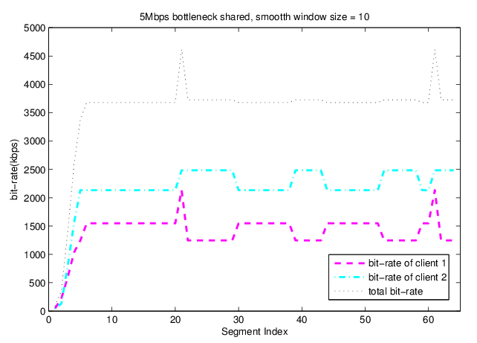
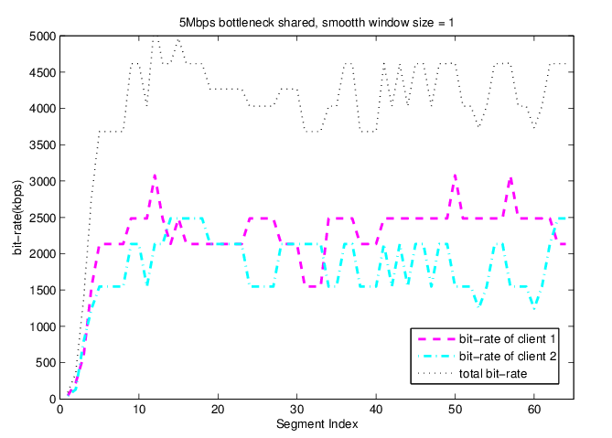
Multi-Users in DASH service (on going)
More practical scenario: multi-users in DASH service environment
Analyze different bitrate adaptation algorithms.
When bitrate adaptation is smoother, fairness and efficiency are less.
Further work:
improve users fairness and efficiency/Trade off between QoE and fairness
Users=2 , smooth window size = 1
Users=2 , smooth window size = 10
Unfairness = 545.9, Utilization = 0.819
Unfairness = 784.3, Utilization = 0.712
Smooth window size: The number of segments which is involved in bandwidth estimation.

Slide 10
Thank You

